Slide 1


Data-Driven Storytelling Presentation:
Comprehensive Analysis and Transformation of Account Sales Data
By
Shivaan Shah

Slide 2
Problem Statement
Key Issues Identified:
Inconsistent and unstructured sales data across multiple accounts hinders comprehensive analysis.
Lack of sorted and organized data makes it difficult to identify top-performing products and accounts.
Existing data presentation does not support quick decision-making or strategic planning.
Business questions:
How have sales trends evolved over time?
What are the sales figures by account?
What is the yearly sales value?

Slide 3
Data Analysis and Visualization
Sales Over Time:
- Depicts trends and patterns in sales performance across different time periods.
Sales by Account:
- Illustrates the distribution of sales among various accounts to identify top-performing clients and potential areas for growth.
Year Sales Value:
- Represents the total sales value achieved each year to assess overall business performance and year-on-year growth.

Slide 4
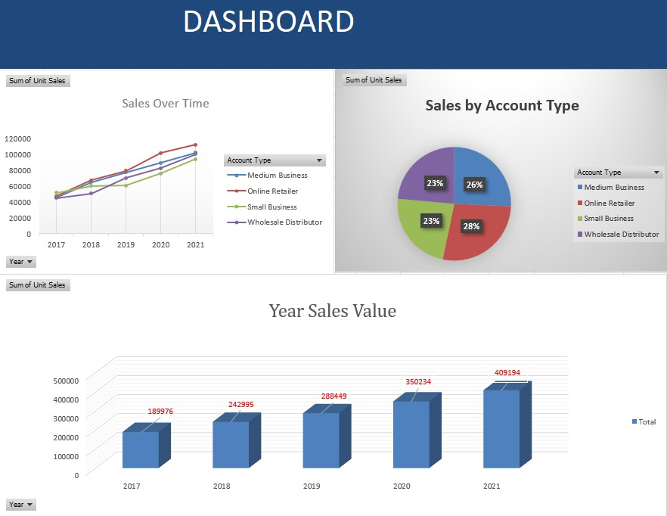
Data Analysis and Visualization

Slide 5
Summary:
Track Sales Trends: Identify patterns and seasonal variations in sales over time.
Prioritize Accounts: Focus on high-value accounts and address issues with underperforming ones.
Evaluate Yearly Sales: Assess overall growth and investigate factors affecting sales performance.
Adjust Strategies: Tailor marketing and sales strategies based on trends, account performance, and yearly sales data.
Review Regularly: Continuously monitor and update strategies based on ongoing sales analysis.

